Slide 1
Introduction
Computer Systems Management
Module Code CT012-3-3
Level 3
VD1

Slide 2
Module Information
Lecturer Name
Khurshid Abdul Jabbar
Email
khurshid@apu.edu.my
Synopsis of Module
This module provides an understanding of analytical models, tools, frameworks and data plan in order to plan or develop IS resources as part of an overall business strategy

Slide 3
Aims of This Module
Provide an insight regarding the understanding of IS and the management of computer systems
Study how IS supports the strategy and structure of organisations
Learn how organizations protect the IS resource, leverage its surrounding eco system, maintain its operations and protect from security threats
Analyse contemporary applications of IS and how to fit them into business strategy

Slide 4
Course Learning Outcomes
At the end of this module, YOU should be able to:
Evaluate scenarios through the use of analytical models, tools and frameworks to plan the acquisition or development of an IS resource as part of an overall business strategy (C5, PLO2)
Propose guideline that are appropriate to secure, protect and maintain information systems resources (A3, PLO4)
Formulate recommendations on contemporary issues in information systems management, control and audit (A4, PLO8)

Slide 5
Mapping of CLO with MOE Domain
Course Learning Outcomes (CLO) |  | Programme Learning Outcomes (PLO) |  |  |  |  |  |  |  |  |  |  |  | Teaching Methods | Assessment
 |  | PLO1 | PLO2 | PLO3 | PLO4 | PLO5 | PLO6 | PLO7 | PLO8 | PLO9 | PLO10 | PLO11 | PLO12
CLO 1 |  |  | ✓ | ▪ | ▪ | ▪ | ▪ | ▪ | ▪ | ▪ | ▪ | ▪ | ▪ | Lecture | Final Exam
CLO 2 |  | ▪ | ▪ | ▪ | ✓ | ▪ | ▪ | ▪ | ▪ | ▪ | ▪ | ▪ | ▪ | Tutorial | Group Assignment
CLO 3 |  | ▪ | ▪ | ▪ | ▪ | ▪ | ▪ | ▪ | ✓ | ▪ | ▪ | ▪ | ▪ | Tutorial | Individual Assignment
 |  | ▪ | ▪ | ▪ | ▪ | ▪ | ▪ | ▪ | ▪ | ▪ | ▪ | ▪ | ▪
PLO2 – Cognitive. Demonstrate intellectual independence, logical & analytical thinking skills to model, design, develop, programme and evaluate efficient computing solution
PLO4 – Interpersonal Skills. Teamwork, interpersonal & social skills with people from diverse learning, working communities and other groups locally and internationally
PLO8 – Leadership Autonomy and Responsibility. Demonstrate effective leadership, professionalism. Work autonomously in managing responsibilities and decision making

Slide 6
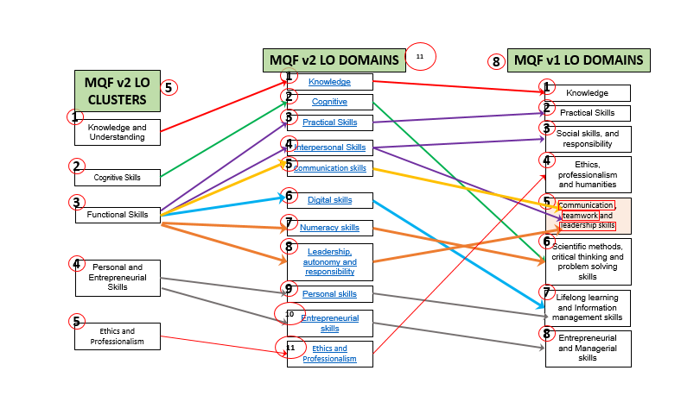
MQF and MOE Domains

Slide 7
Outcome-Based Education (OBE)
OBE is education based on producing particular educational outcomes that:
  Focus on what students can actually do after they are taught
  Expect all learners / students to successfully achieve particular (sometimes minimum) level of knowledge and abilities.

Slide 8
What is OBE
It is
NOT
What we want to teach
It is
What you should learn

Slide 9
Teaching Strategies
Lectures
Tutorials
Quizzes
Group Discussions

Slide 10
Student Learning Time (SLT)
Course Credit Value: 3
Total Learning Hours:
Lecture: 28 hours per semester
Tutorial: 21 hours per semester
Independent Learning Time: 59 hours

Slide 11
What is Expected of You
Student participation in class
  Group Discussions
  Presentations
  Quiz and Quick tests
  Research

Slide 12
Course Content Outline
CLO1 - Exam (50%)
Lecture
Introduction
Porter’s Five Forces
Competitive Advantage
Information Systems Strategy
Managing Global Systems
Supply Chain I
Supply Chain II
Systems Security
Managing Systems Security
DR
E-Commerce 12. Summary

Slide 13
Course Content Outline
CLO2 : Group Assignment (20%)
Tutorials:
Research on Porter’s Five Forces, Competitive Analysis, IS Strategies
Investigation on Business Strategies, Information Resources
Recommendations on Business Strategy, Processes, Tools and Techniques
Slide <<number>> of 20

Slide 14
Course Content Outline
CLO3 : Individual Assignment (30%)
Tutorials:
Research and Case Study on Information management, Control, Audit
Case Study and Recommendations on Security Management, Industrial Competitition and Techniques
Slide <<number>> of 20

Slide 15
References
Supply Chain Management: Strategy Planning Operations by Sunil Chopra & Peter Meindl (2016) 6th Ed. Pearson. (ISBN: 9781292093567)
Management Information Systems – Managing the Digital Firm by Kenneth C. Laudon and Jane P. (2015) Laudon, 14th Ed. Pearson. (ISBN: 9781292094007)
Electronic Commerce by Gary P. Schneider (2015) 11th Ed. Cengage Technology. (ISBN: 9781305044258)
Further Reading
4. The Strategic Management of Information Systems by Joe Peppard & John Ward (2016) 4th Ed. John Wiley and Sons (ISBN: 9780470034675)

Slide 16
What Support is Available for You
Consultation hours
Email : khurshid@apu.edu.my
Reference Materials
Internet resources

Slide 17
How You will be Assessed
In-Course Assessment 50%
Group + Individual Components
Exam 50%

Slide 18

Question and Answer Session
Question and Answer Session
Q & A

Slide 19
What We will Cover Next
Competitive Advantage – Porter’s Five Forces

